Slide 1
HOSPITAL INFORMATION
PRESENTED BY
B.SWATHI , J.SWETHA
CYBYRUS TEAM

Slide 2
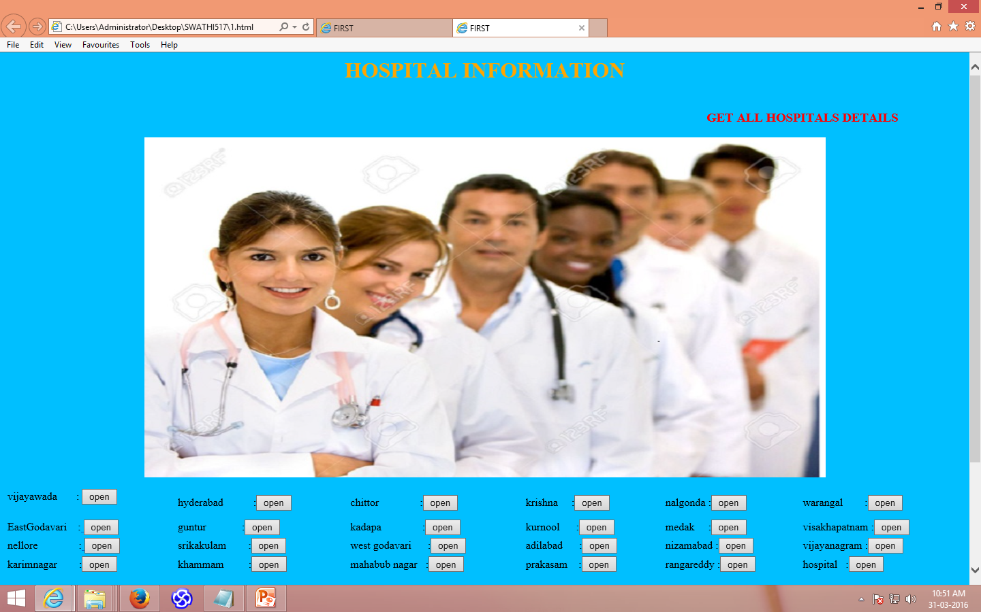
THIS WEBSITE PROVIDES INFORMATION ABOUT ALL HOSPITALS IN AP

Slide 3
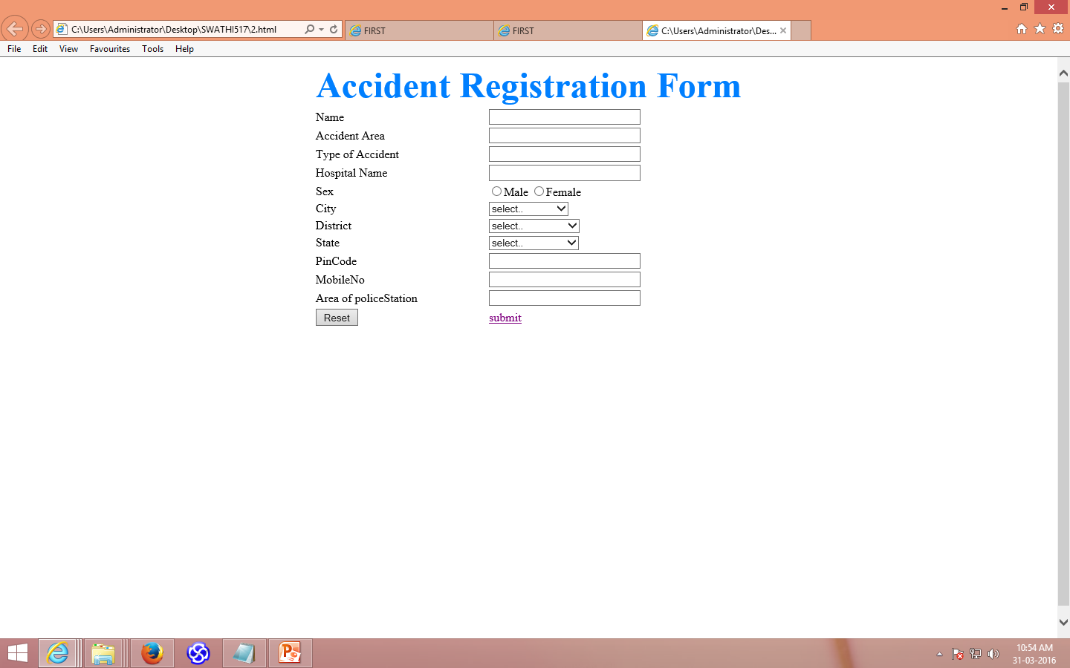
ACCIDENT REGISTRATION FORM PROVIDES FACITLITY TO REPORT AN ACCIDENT THROUGH ONLINE

Slide 4

THANKS FOR USING THIS WEBSITE

